Slide 1
RAG with vision models
Pamela Fox, Python Cloud Advocate
@pamelafox
pamelafox.org

Slide 2
Agenda
Multimodal LLMs
Multimodal embedding models
RAG with vision

Slide 3
Multimodal LLMs

Slide 4
Multimodal LLMs on Azure
These LLMs can accept either text or image as input, or both.
Creator | Models | How to use on Azure?
OpenAI | GPT-4o, GPT-4o-mini | Azure OpenAI, GitHub Models
Microsoft | Phi3-vision | Azure AI Model Catalog
https://azure.microsoft.com/products/ai-services/openai-service
https://github.com/marketplace/models
https://ai.azure.com/

Slide 5
Using gpt-4o from OpenAI SDK in Python
messages = [{
"role": "user",
"content": [
{"text": "Is this a unicorn?",
"type": "text"},
{"image_url":
{"url": "https://upload.wikimedia.org/wikipedia/commons/6/6e/Ur-painting.jpg"},
"type": "image_url"}],
}
]
response = openai_client.chat.completions.create(
model="gpt-4o",
messages=messages
)
aka.ms/chat-vision-app: notebooks/chat_vision.ipynb

Slide 6



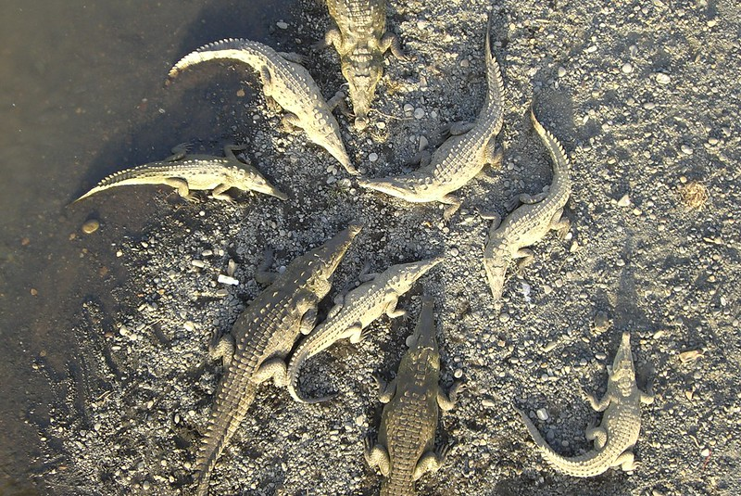

A basic chat with vision app
Alligators or crocodiles?
Backend
LLM
Those appear to be crocodiles, based on their V-shaped snouts.
User
Question
aka.ms/chat-vision-app

Slide 7
Multimodal embedding models

Slide 8
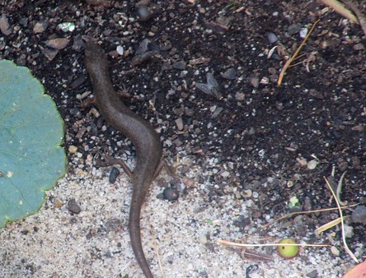
Azure AI Vision: Florence model
Use Azure AI Vision API to generate embeddings from the powerful Florence model.
[
3.3652344,
0.8413086,
1.2783203,
...],
/vectorizeImage
[
-0.027022313,
-0.011945606,
0.019690325,
...],
"creepy reptile that looks kind of like a snake but also like a lizard"
/vectorizeText

Slide 9
Using Azure AI Vision API from Python
def get_image_embedding(image_file):
mimetype = mimetypes.guess_type(image_file)[0]
url = f"{AZURE_COMPUTER_VISION_URL}:vectorizeImage"
headers = get_auth_headers()
headers["Content-Type"] = mimetype
response = requests.post(url, headers=headers,
params=get_model_params(), data=open(image_file, "rb"))
return response.json()["vector"]
def get_text_embedding(text):
url = f"{AZURE_COMPUTER_VISION_URL}:vectorizeText"
response = requests.post(url, headers=get_auth_headers(),
params=get_model_params(), json={"text": text})
return response.json()["vector"]
aka.ms/aitour/azure-search

Slide 10
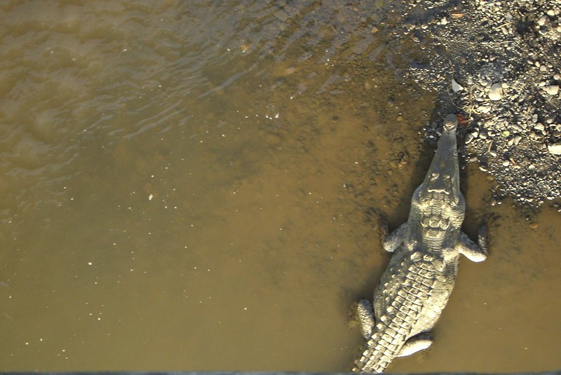
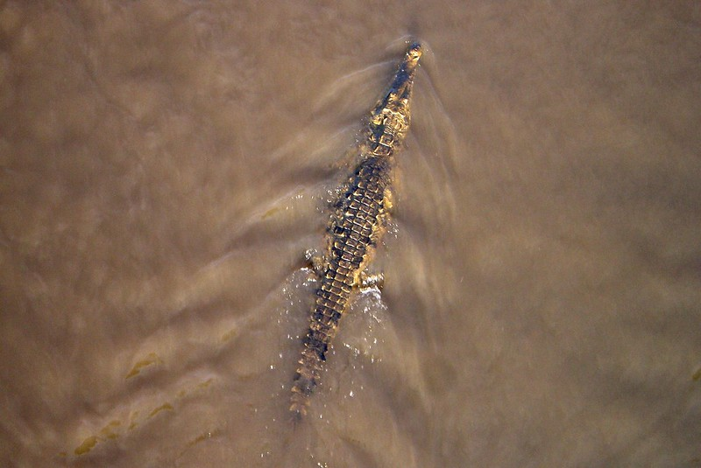
Vector search with multimodal embeddings
/vectorizeImage
Vector search
alligator
/vectorizeText
Vector search
aka.ms/aitour/azure-search

Slide 11
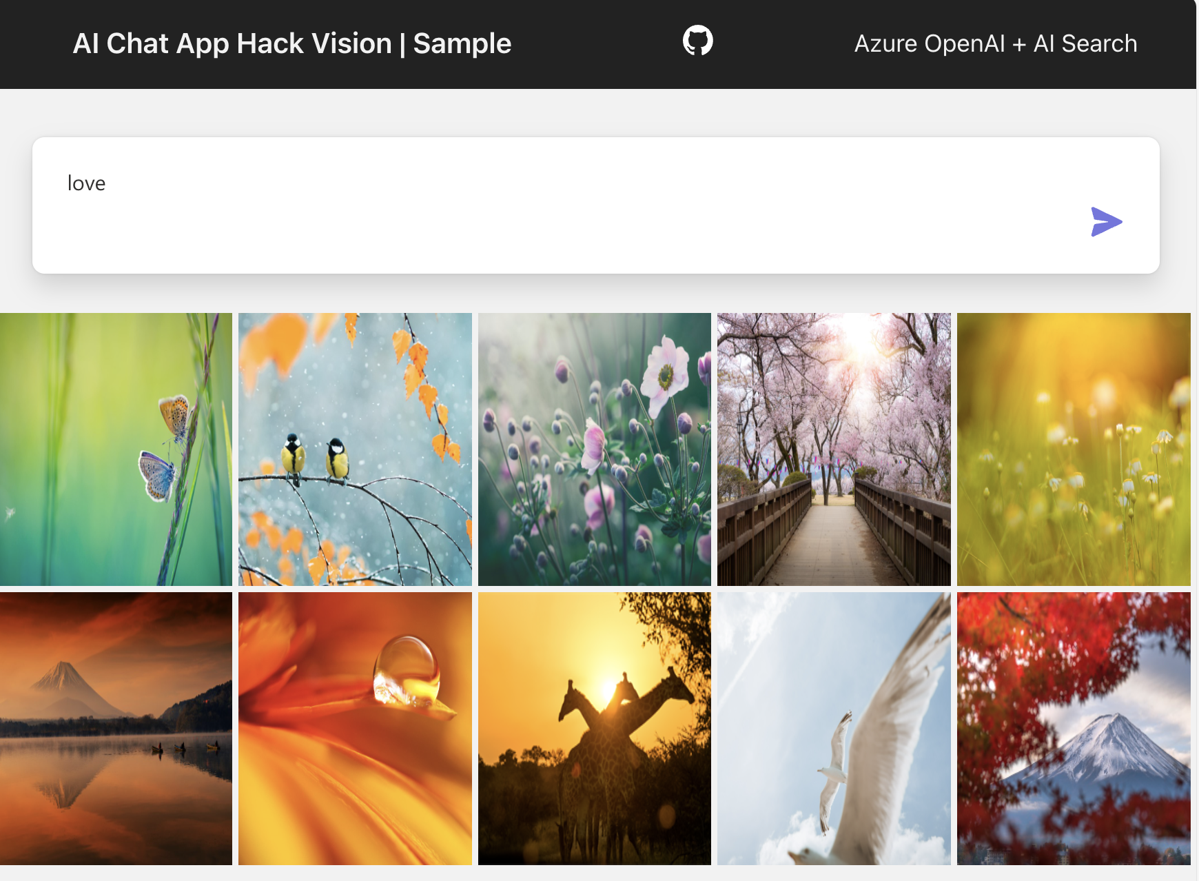
Product image search app
Azure AI Vision +
Azure AI Search +
Azure App Service + Azure Functions
Code:
aka.ms/aisearch-images-app

Slide 12
RAG with vision

Slide 13

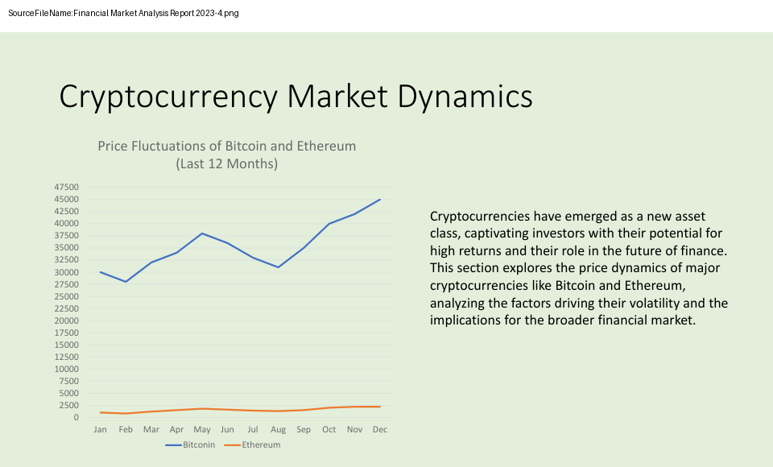
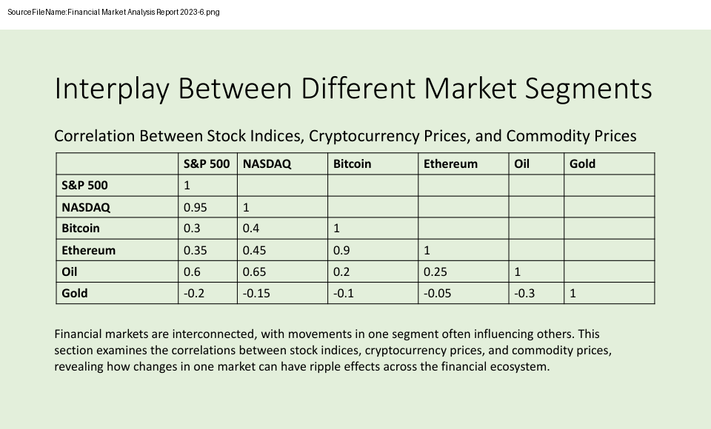
RAG on multimodal documents
Yes, there is a correlation between oil prices and
stock market trends²
Is there any correlation between oil prices and stock market trends?
“Is there any…”
“Is there any…”
“Is there any…”
[[0.0014615238, -0.015594152, -0.0072768144, -0.012787478,…]
Text embedding model
Financial Market Analysis 2023-6.png
This section examines the correlations between stock indices, cryptocurrency prices...
User
Question
Multivector
Hybrid Search
Multimodal LLM
“Is there any…”
[[0.0021338, -0.01123152, -0.0238144, -0.0123478,…]
Multimodal
embedding model

Slide 14
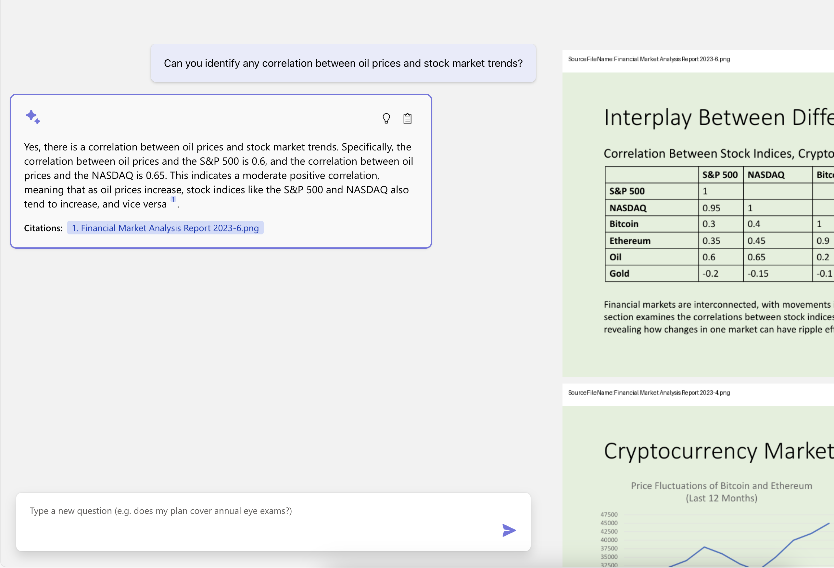
RAG on multimodal documents: Open-source solution
Azure OpenAI +
Azure AI Search +
Azure AI Vision +
Azure App Service +
Main repo:
aka.ms/ragchat
Setup guide:
aka.ms/ragchat/vision
Demo:
aka.ms/ragchat/demo
Enable "GPT vision" in Settings

Slide 15



RAG on multimodal documents: Azure architecture
Yes, there is a correlation between oil prices and
stock market trends²
Is there any correlation between oil prices and stock market trends?
“Is there any…”
“Is there any…”
“Is there any…”
[[0.0014615238, -0.015594152, -0.0072768144, -0.012787478,…]
OpenAI
text embedding
Financial Market Analysis 2023-6.png
This section examines the correlations between stock indices, cryptocurrency prices...
User
Question
Azure AI Search
OpenAI
gpt-4o
“Is there any…”
[[0.0021338, -0.01123152, -0.0238144, -0.0123478,…]
AI vision API
/vectorizeText

Slide 16




Data ingestion for textual PDFs
This is a typical ingestion process that can be highly customized to meet the domain needs:
Azure Blob Storage
Azure Document
Intelligence
Azure OpenAI
Azure
AI Search
Python
Upload documents
An online version of each document is necessary for clickable citations.
Extract data from documents
Supports PDF, HTML, docx, pptx, xlsx, images, plus can OCR when needed.
Local parsers also available for PDF, HTML, JSON, txt.
Split data into chunks
Split text based on sentence boundaries and token lengths.
Langchain splitters could also be used here.
Vectorize chunks
Compute embeddings using OpenAI embedding model of your choosing.
Indexing
Document index
Chunk index
Both
Notes:
So here is what a data ingestion process could look like.
First, we store the documents in Azure Blob Storage, so that we have a version of the file that can be rendered as a citation in the app.
Then, we extract the text from the documents, using Azure Document Intelligence or a local parser.
Next, we split the data into chunks based on optimal token length and sentence boundaries.
We take those chunks and compute embeddings for them using an embedding model, like the Azure OpenAI embedding models.
Finally, we store the text, embedding, and Blob storage link inside the Azure AI search index.
This whole data ingestion process can run as a Python script locally, and that's what we've done in our open source RAG solution.

Slide 17
Data ingestion for visual PDFs
We actually use both ingestion strategies on each PDF since they may contain both visuals and text.
Azure Blob Storage
Azure AI
Vision
Azure
AI Search
Python
Split PDFs
into pages
&
Generate image of each page
Upload images
Necessary for rendering citations in the app UI
Vectorize images
Index images
Store embedding in imageEmbedding field
Store image filename in sourcepage field
Notes:
So here is what a data ingestion process could look like.
First, we store the documents in Azure Blob Storage, so that we have a version of the file that can be rendered as a citation in the app.
Then, we extract the text from the documents, using Azure Document Intelligence or a local parser.
Next, we split the data into chunks based on optimal token length and sentence boundaries.
We take those chunks and compute embeddings for them using an embedding model, like the Azure OpenAI embedding models.
Finally, we store the text, embedding, and Blob storage link inside the Azure AI search index.
This whole data ingestion process can run as a Python script locally, and that's what we've done in our open source RAG solution.

Slide 18
Generating citable images
In order for the model to provide an answer with citations, we must bake the filename into the image:

Slide 19
System prompt for multimodal RAG answering
You are an intelligent assistant helping analyze the Annual Financial Report of Contoso Ltd. The documents contain text, graphs, tables and images.
Each image source has the file name in the top left corner of the image with coordinates (10,10) pixels and is in the format SourceFileName:<file_name>
Each text source starts in a new line and has the file name followed by colon and the actual information
Always include the source name from the image or text for each fact you use in the response in the format: [filename]
Answer the following question using only the data provided in the sources below.
If asking a clarifying question to the user would help, ask the question.
Be brief in your answers.
The text and image source can be the same file name, don't use the image title when citing the image source, only use the file name as mentioned.
If you cannot answer using the sources below, say you don't know. Return just the answer without any input texts.

Slide 20
Considerations for multimodal RAG
👻 Beware noisy vector embeddings!
Only generate embeddings for meaningful imagery.
You may want to use an LLM to describe the images and search the descriptions instead.
Allow users to upload an image and search by image as well.
Overview of the process:
https://blog.pamelafox.org/2024/09/integrating-vision-into-rag-applications.html

